Slide 1







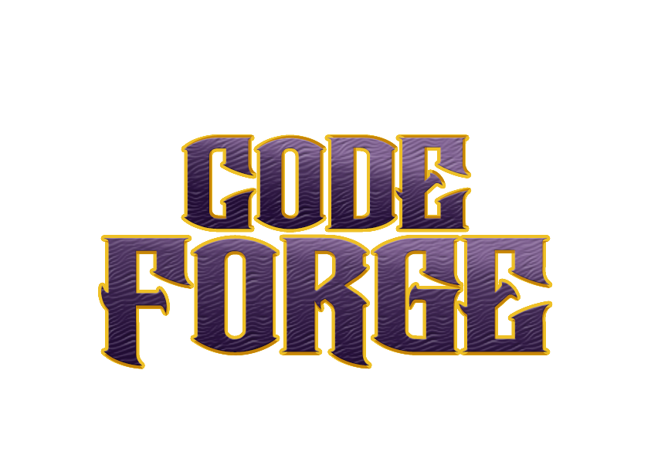

Idea submission

Slide 2


Team details
Team Lead: Name: Shivayogi
Contact : 9008855283
Email :shivayogi.cs24@bmsce.ac.in
Team Member 2: Name: Shreyas S
Contact : 9353431758
Email :shreyass.cs24@bmsce.ac.in
Team Member 3: Name: Shraddha M
Contact : 6362998451
Email : shraddham.cs24@bmsce.ac.in

Slide 3


Our solution
This AI-powered Meeting Summarizer & Translator transcribes speech in real time using Vosk, summarizes key points with Sumy (LSA summarization), and translates summaries into multiple languages via Google Translator API. The PyQt5-based GUI allows users to start/stop recording, view transcriptions, generate summaries, and translate them with a simple interface. Multithreading ensures smooth processing without UI lag, making it ideal for meetings, lectures, and multilingual communication. 🚀

Slide 4

TECHNICAL APPROACH
Speech Recognition:
Vosk: Offline speech-to-text processing using the Vosk API.
Text Summarization:
Sumy: Extracts key sentences using the Latent Semantic Analysis (LSA) summarizer.
Translation:
Deep Translator (GoogleTranslator): Translates summaries into multiple languages.
Graphical User Interface (GUI):
PyQt5: Used for building the desktop application with buttons, text fields, and layouts.
Audio Handling:
Sounddevice: Captures and processes audio input in real time.
Queue: Manages real-time audio data storage and processing.
Multithreading:
QThread (PyQt5): Ensures smooth UI updates while processing audio in the background.
Data Handling & JSON Parsing:
JSON: Parses transcription data from Vosk for further processing.
System & File Handling:
OS & SYS: Manages file paths and system-level operations.
These technologies work together to transcribe speech, summarize key points, and translate content in a user-friendly PyQt5 GUI. 🚀

Slide 5
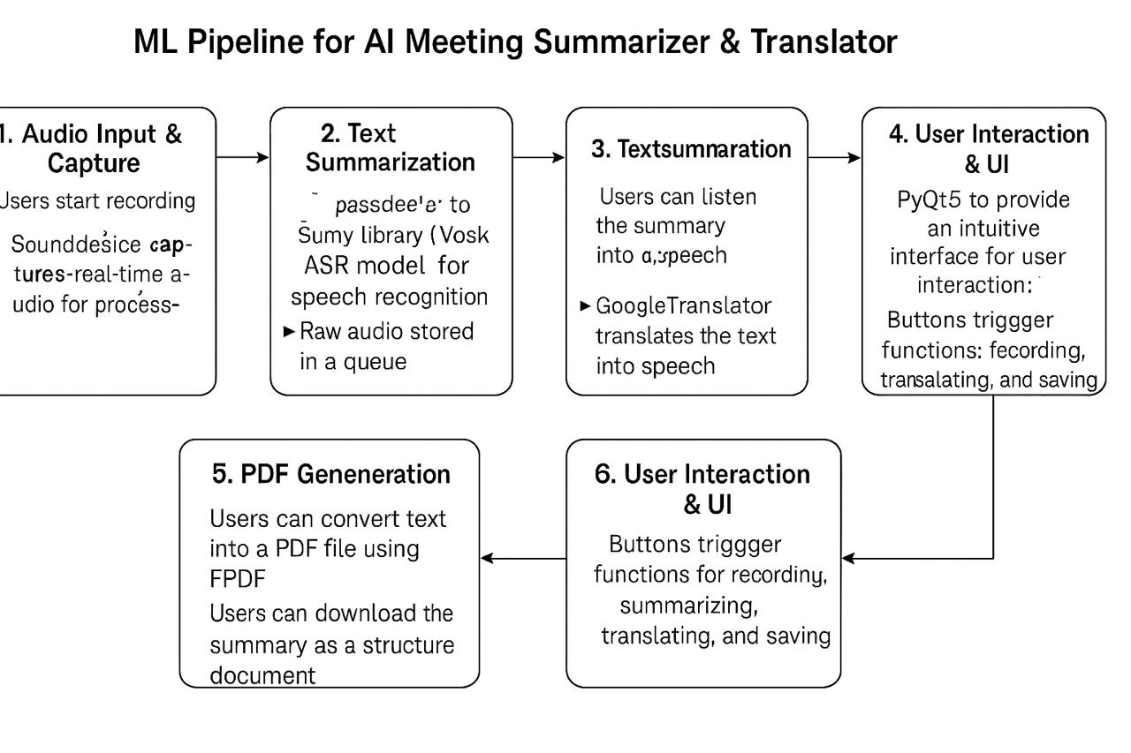
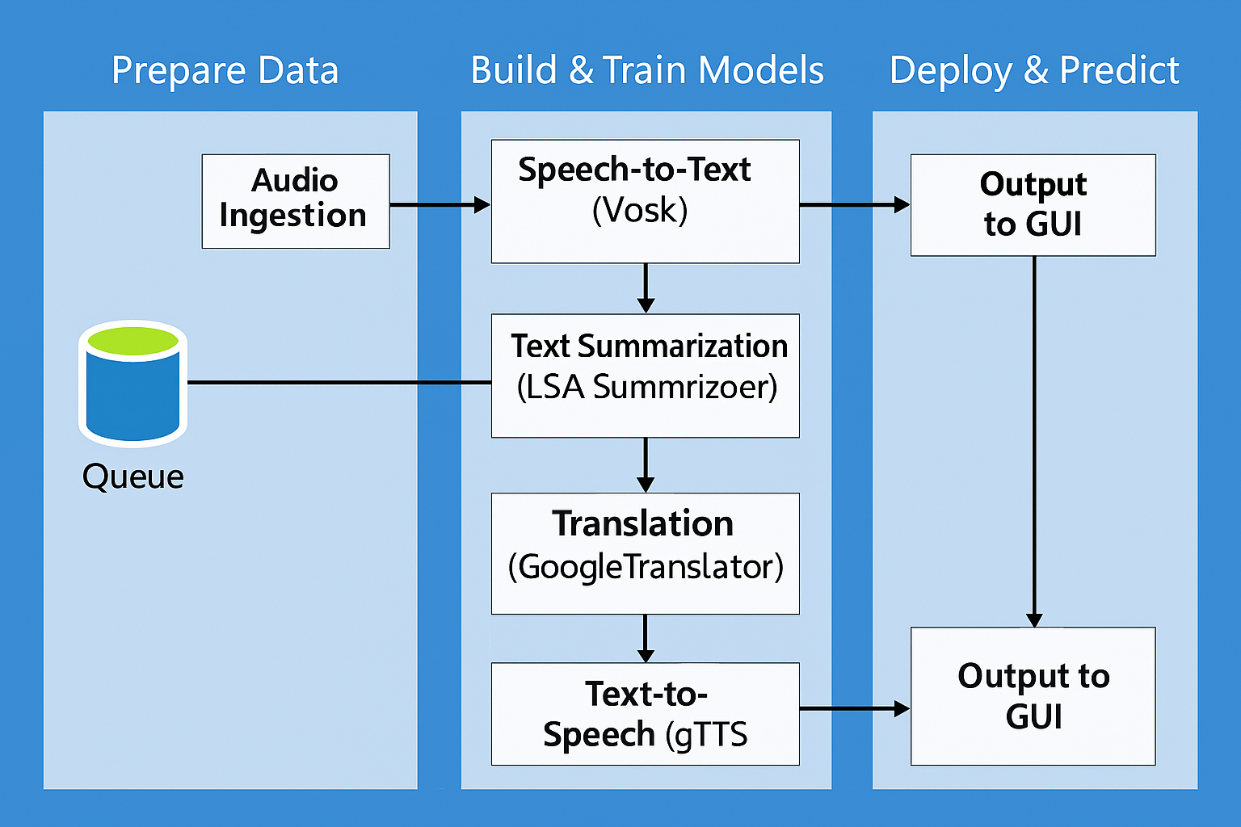
Workflow/pipeline

Slide 6
Feasibility & FUTURE SCOPE
Feasibility:
This AI-powered meeting summarizer is feasible due to advancements in speech recognition (Vosk), natural language processing (Sumy), and translation (Google Translator). The integration with PyQt5 for UI, GTTS for text-to-speech, and FPDF for generating PDFs makes it user-friendly and efficient. However, real-time processing accuracy depends on the quality of input audio and model optimization.
Future Scope:
Cloud Integration – Store transcriptions and summaries for remote access.
Multi-Speaker Identification – Enhance accuracy by distinguishing between different speakers.
Customizable Summarization – Enable users to select different summarization techniques.
Real-Time Translation – Extend translation capabilities to live speech-to-text.
Mobile & Web Application – Develop a cross-platform version for broader accessibility.

